Slide 1
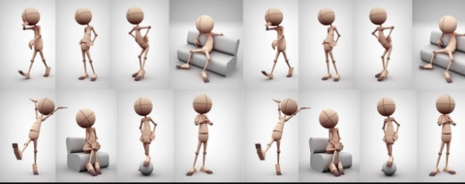
NON VERBAL COMMUNICATION

Slide 2

Read the picture

Slide 3


Slide 4


Slide 5
